Slide 1

Predicting Future Claims
Data Scientist Recruiting Work Sample
Eric Hang

Slide 2
Overview
EDA of Claims Data (Dataset 1)
EDA of Subsequent Loss Experience (Dataset 3)
EDA of Predictor Dataset (Dataset 2)
Cleaning Predictor Data (Dataset 2)
Correlation Analysis and Adjustments
Final Modeling Dataset
Logistic Regression and Model Evaluation
Quasi-Complete Separation
Final Model and Interpretation
Concluding Comment

Slide 3
1. EDA of Claims Data (Dataset 1)

Slide 4
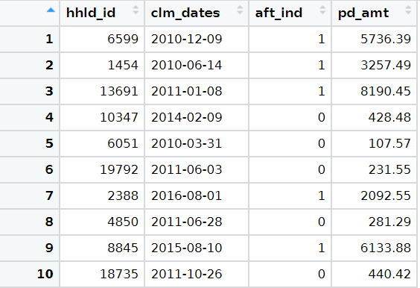
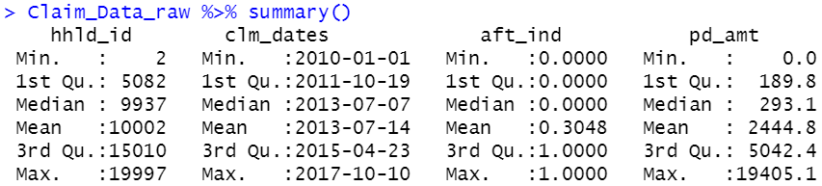
First Impressions
Historical Paid Claim Data 2010 – 2017
Per Claim-level data (as opposed to per-claimant or per-occurrence)
Assume Paid Losses are closed and trended to the same (current) level
Overall, data appears reasonable

Slide 5
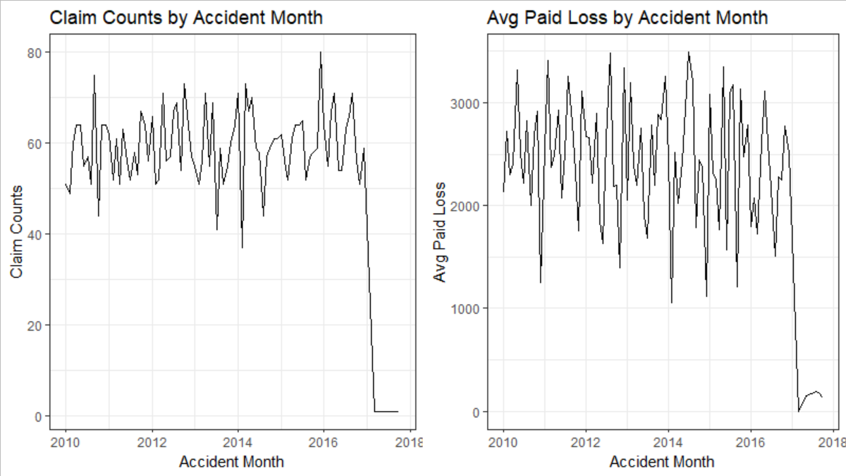
Claim Counts and Avg Paid by Accident Month
Drop off in Claims post-2017, and potential seasonality/cyclicality in paid experience?

Slide 6
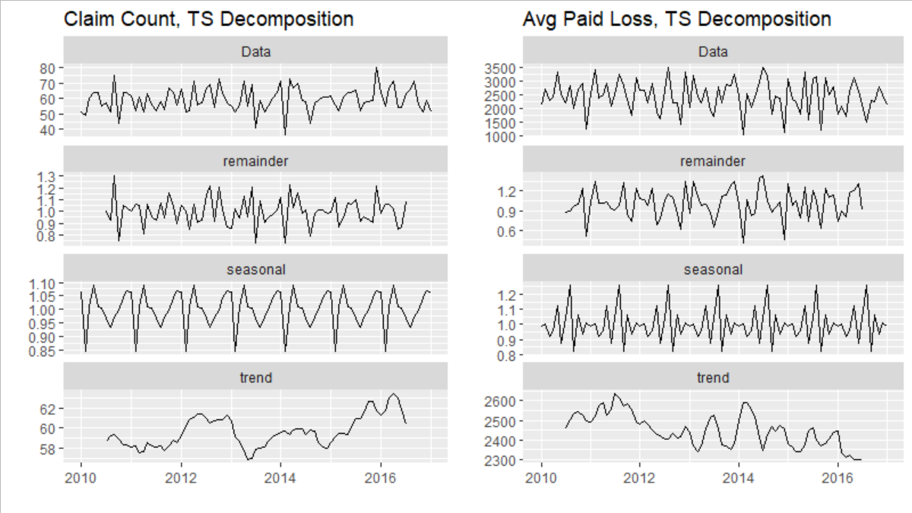
Multiplicative TS Decomposition (excl. 2017)
Slight decrease in Paid Severity overtime, but decomp. inconclusive due to large residuals
Perhaps fewer paid claim counts at BOY due to holidays and thus fewer claims adjusters

Slide 7
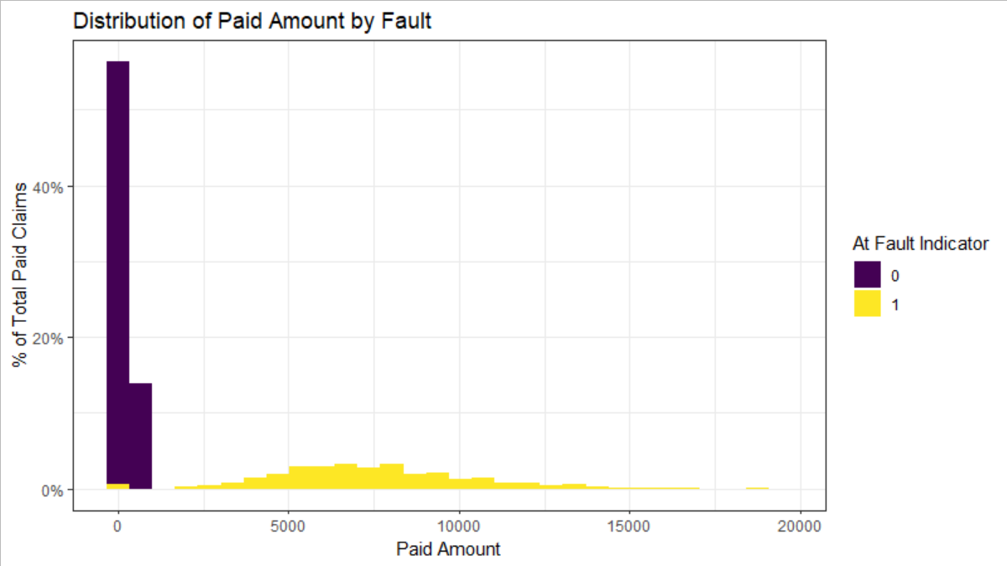
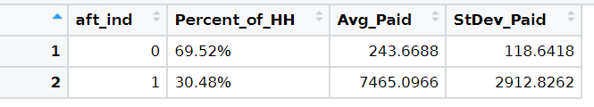
Distribution of Paid Amounts, by Fault
Households Not At-Fault (70%) result in minimal claim payment

Slide 8
Claims Data
Outstanding Questions and Assumptions
What coverage are these losses for? Assume all data is for the same auto coverage
Limits and Deductibles? Will affect claim payment severity
Assume Paid Amounts are trended to same (current) level
Ignore No-Fault states for Simplicity

Slide 9
2. EDA of Subsequent Loss Experience (Dataset 3)

Slide 10
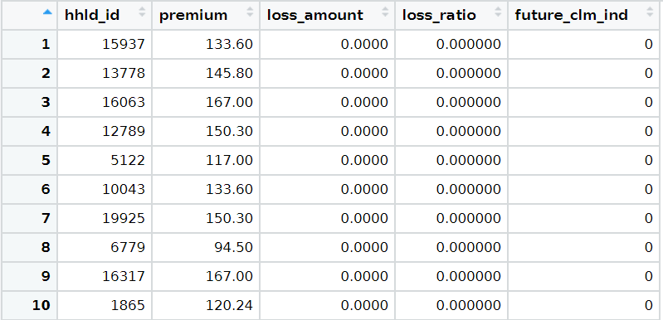
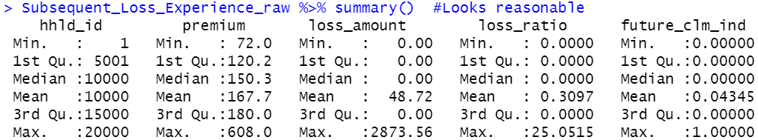
First Impressions
Most Premium < $200
Losses are (presumably) undeveloped and immature, given their size
Individual claimant loss ratios are not meaningful
Only 4% of households have incurred claims
Overall, data appears reasonable

Slide 11
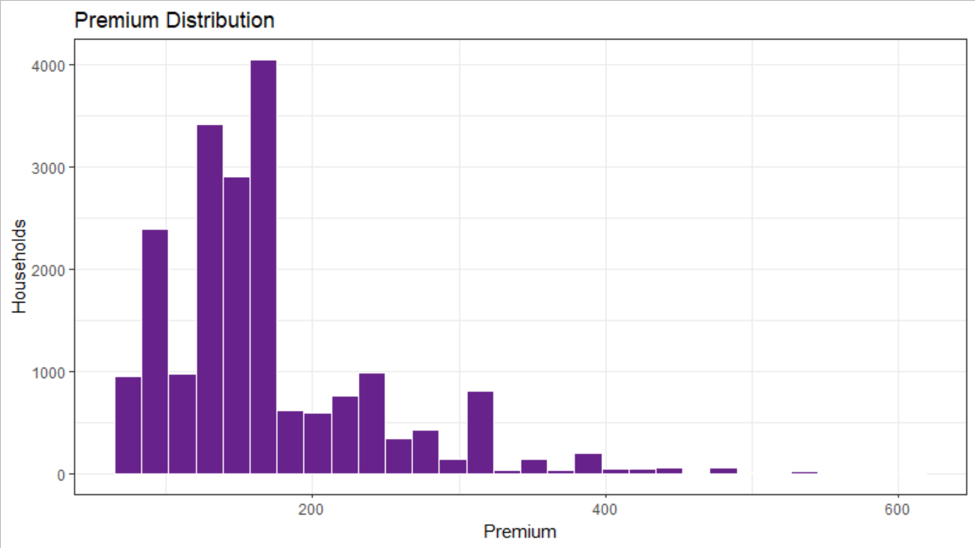
Premium Distribution

Slide 12
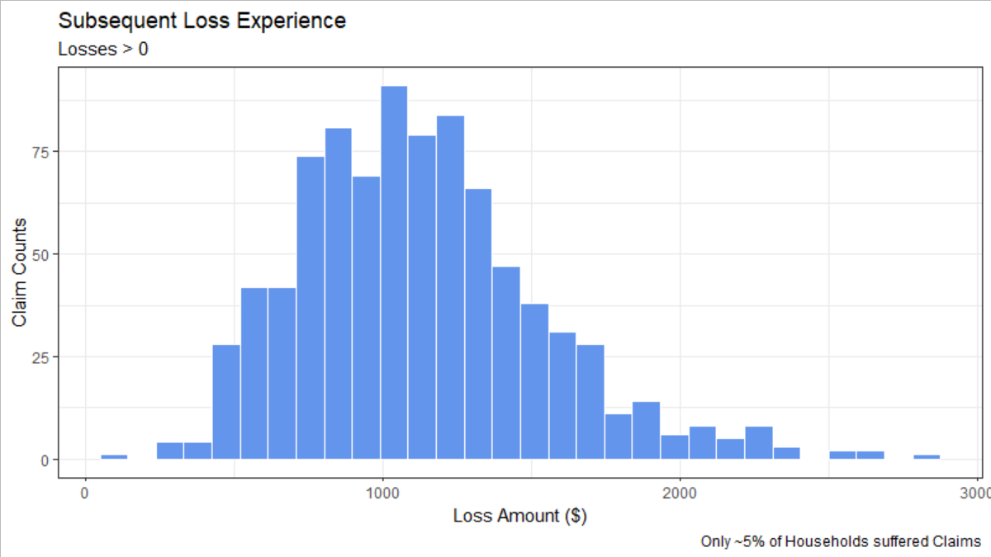
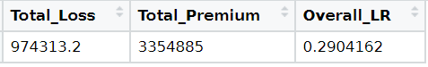
Distribution of Subsequent Loss Experience
Losses are likely immature and undeveloped (e.g. compared to Dataset 1 paid losses); Overall Loss Ratio of 29% expected to eventually deteriorate

Slide 13
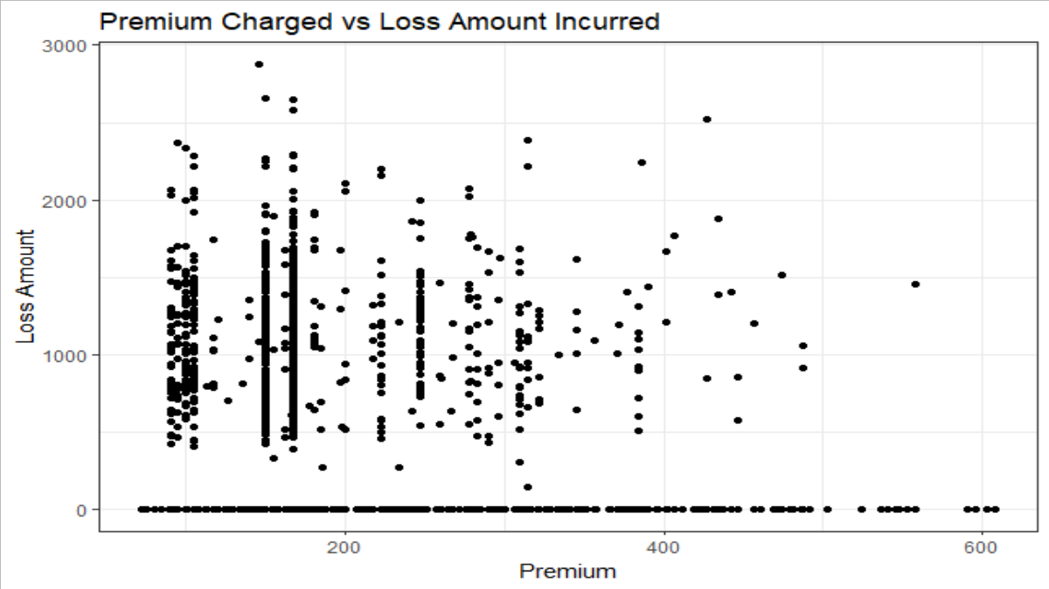
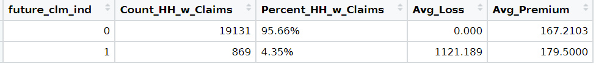
(Surprisingly) Weak Relationship between Premium and Loss
0.035 Correlation between Premium and Loss

Slide 14
Subsequent Loss Experience
Outstanding Questions and Assumptions
Assume claim counts/losses/ premium for same specified coverage only
Assume Full Amount of (annual) premium is received
Assume claims are fully-reported, but losses are undeveloped

Slide 15
3. EDA of Predictor Dataset (Dataset 2)

Slide 16
Group Related Predictor Variables together for Analysis
Grouped variables have higher risk of correlation and/or multi-collinearity

Slide 17
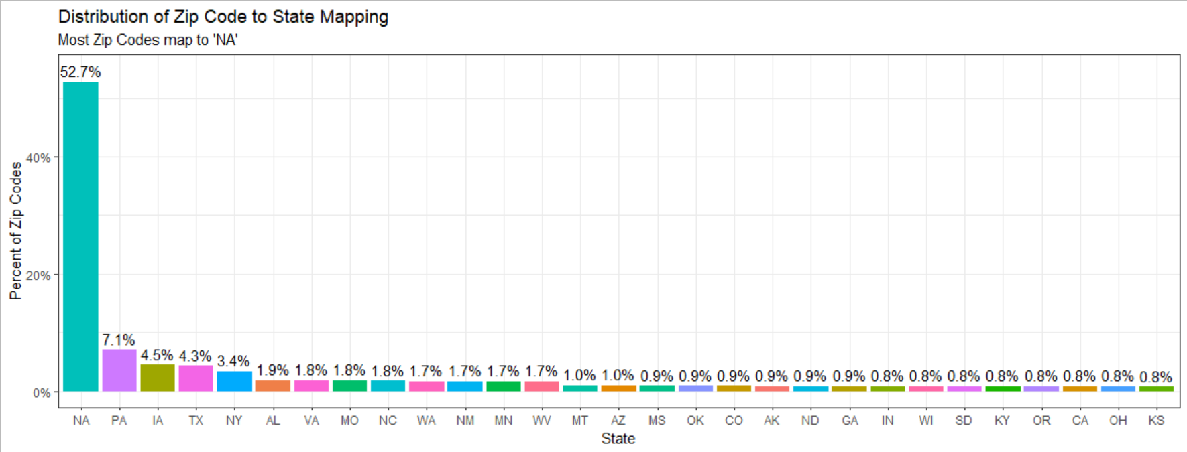
Zip Code to State Mapping
Zip Codes are mostly invalid (probably censored)
Notes:
Spot checked – several nonsensical/invalid Zip Codes or Zip Codes in Europe

Slide 18
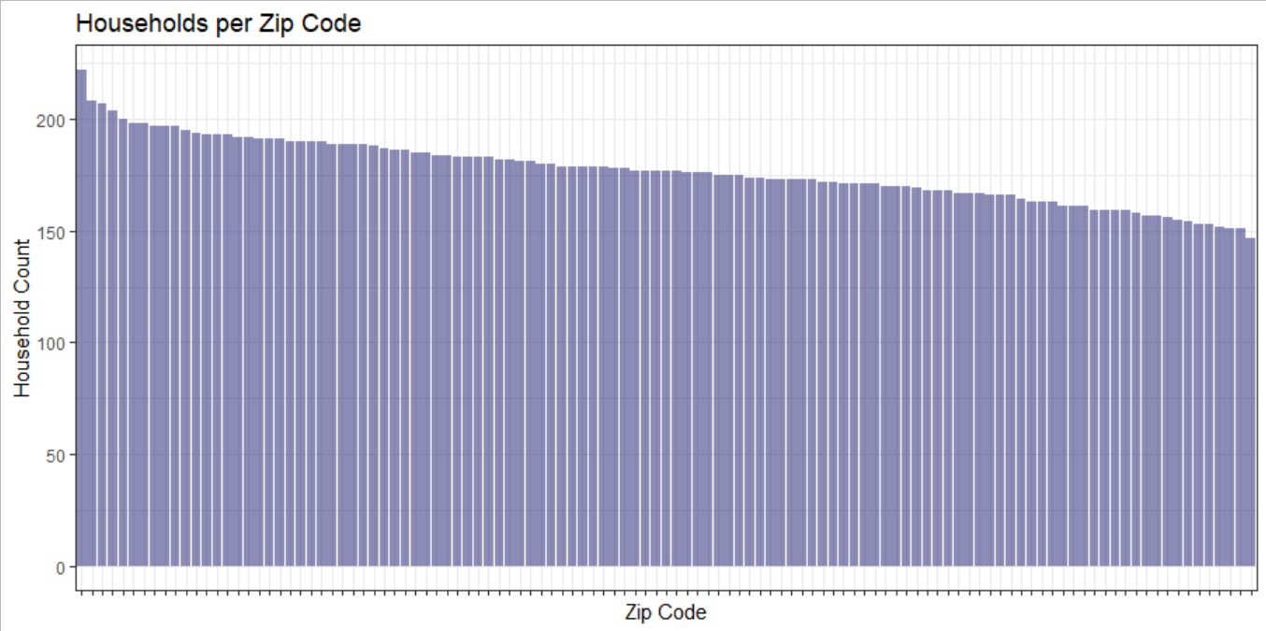
Count of Households per Zip Code
Without mapping to state, too many zip code levels to include in model, relative to total data

Slide 19
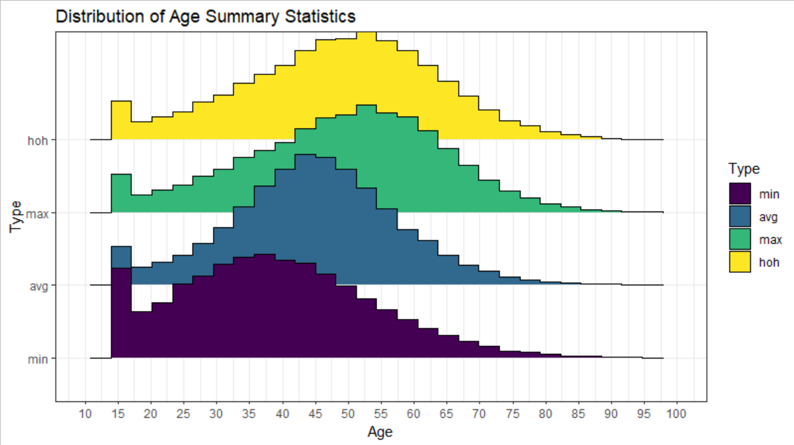
Household Age Distribution
Point mass at ~16 for younger drivers, but otherwise normally distributed
Notes:
Head-of-Household age lines up with max age, implying Head-of-Household is usually the oldest in the family

Slide 20
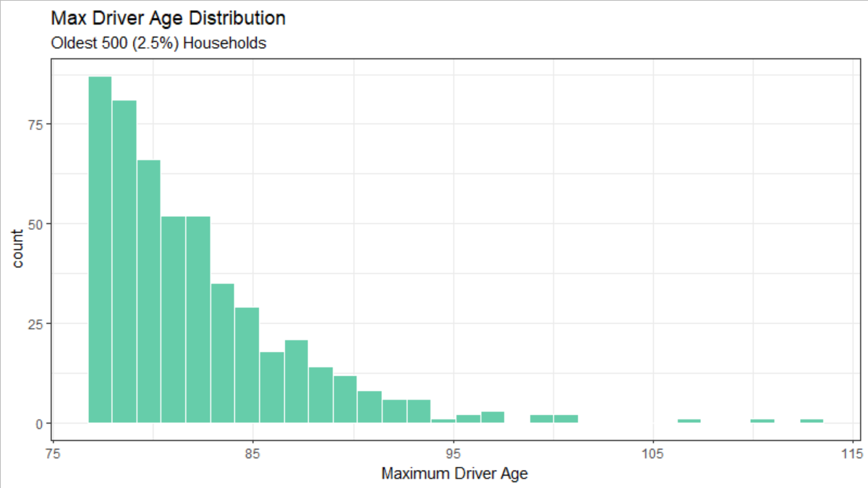
Age Outliers
Age Distribution is reasonable overall (strong Normal distribution) – not too concerned

Slide 21
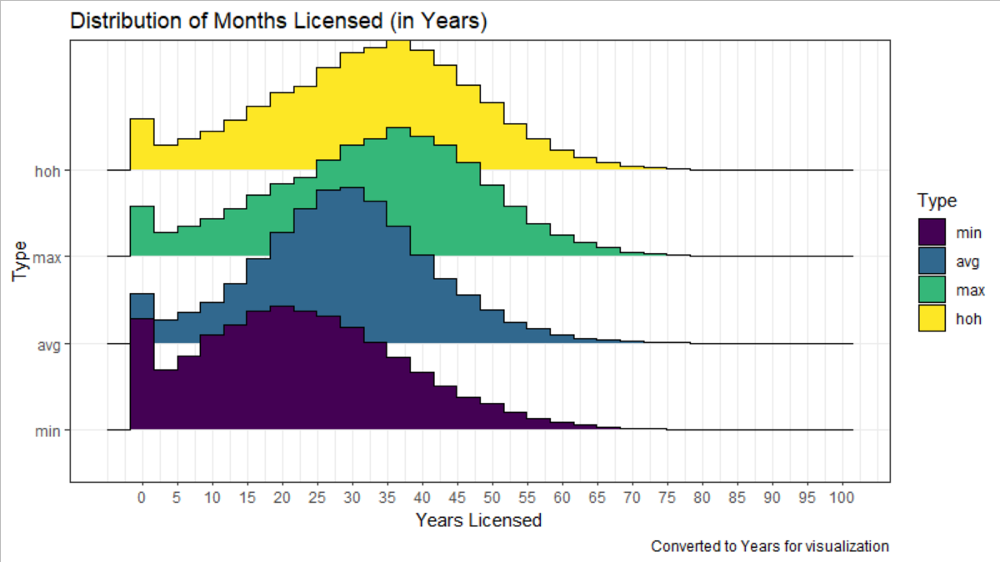
Months Licensed Distribution
Appears to be Age Distribution, shifted by ~16 years; unlikely to offer unique information
Notes:
Expect extremely high correlation with Age

Slide 22
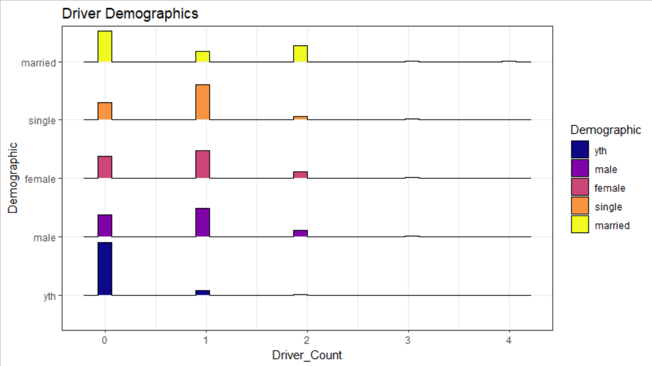
Driver Demographics
Single/Married, and Male/Female are likely to be complementary

Slide 23
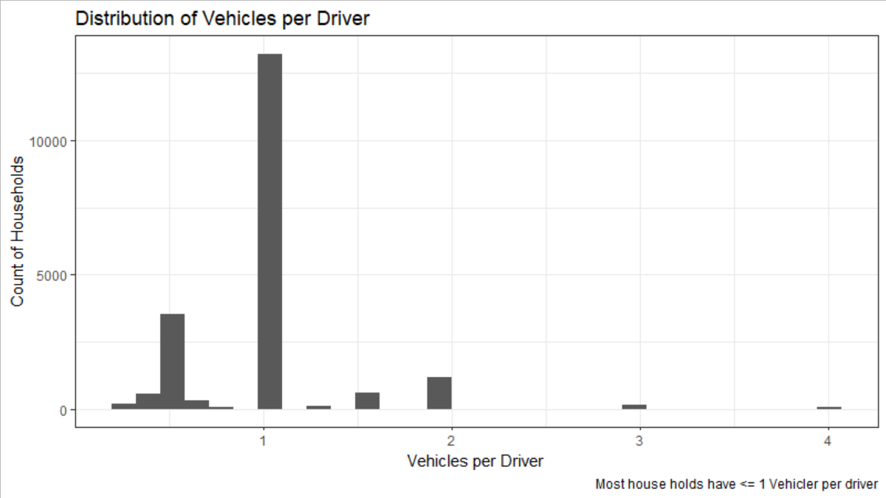
Distribution of Vehicles per Driver
Most households have a 1:1 ratio of Vehicles : Drivers

Slide 24
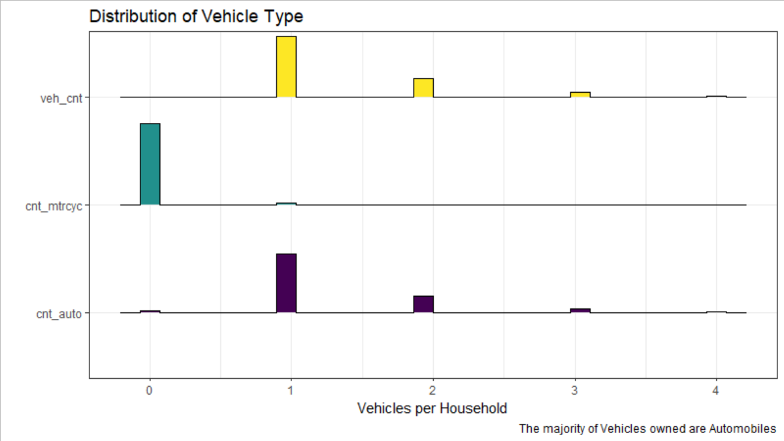
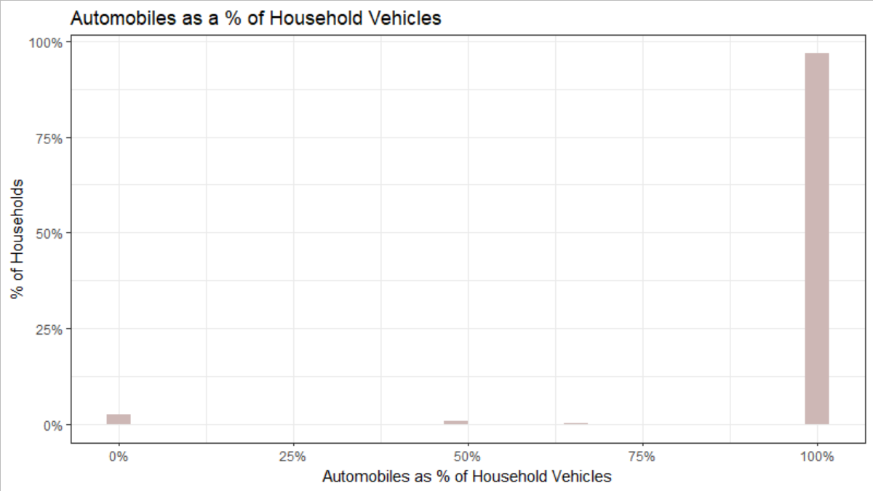
Vehicle-Types
Most vehicles owned are Automobiles
Notes:
Note: Motorcycles + Automobiles = Total Vehicle Count

Slide 25
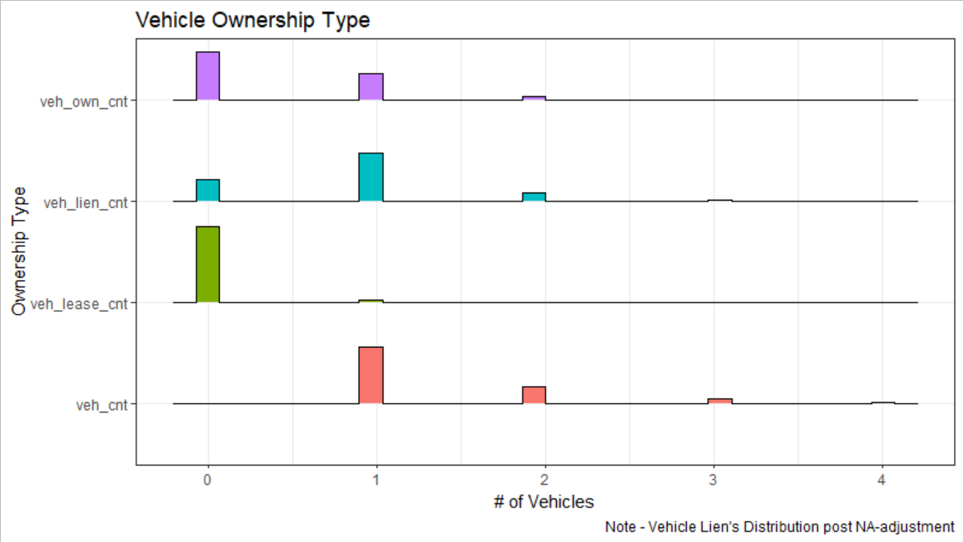
Distribution of Vehicle Ownership
Owned and Liened Vehicles are most common

Slide 26
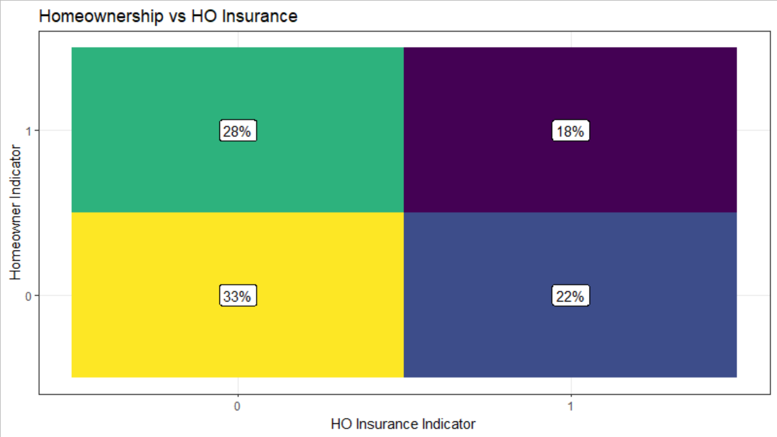
Homeownership vs HO Insurance
Approximate 50-50 split for Homeownership and 40-60 split for HO Insurance

Slide 27
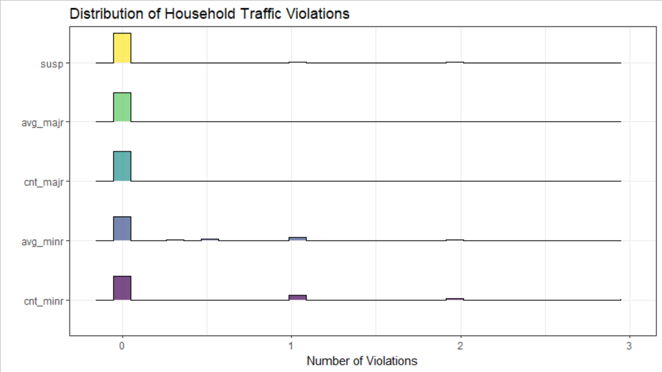
Traffic Violations and Suspensions
Most households do not have any Traffic Violations

Slide 28
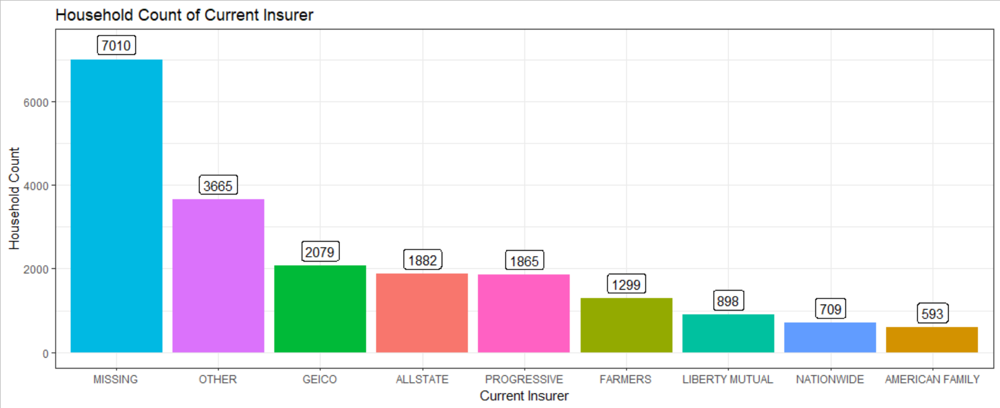
Current (Prior) Insurer
35% Households are NOT Currently Insured (Missing)

Slide 29
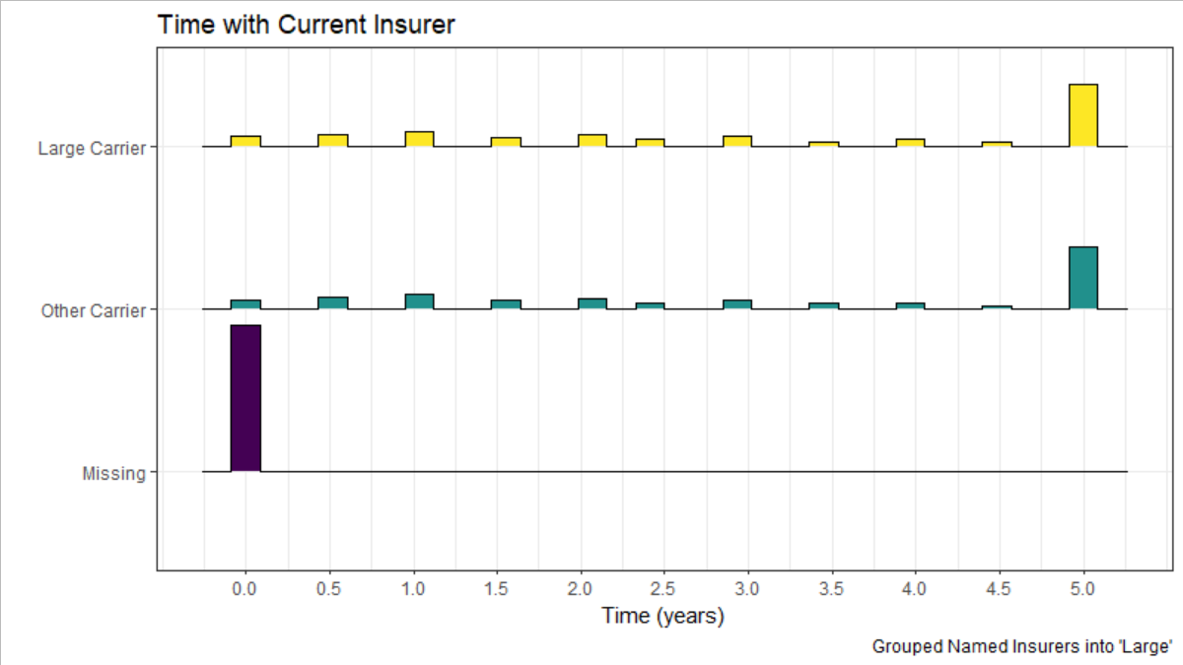
Time with Current (Prior) Insurer
Most currently insured households have been with their current insurer for 5+ years

Slide 30
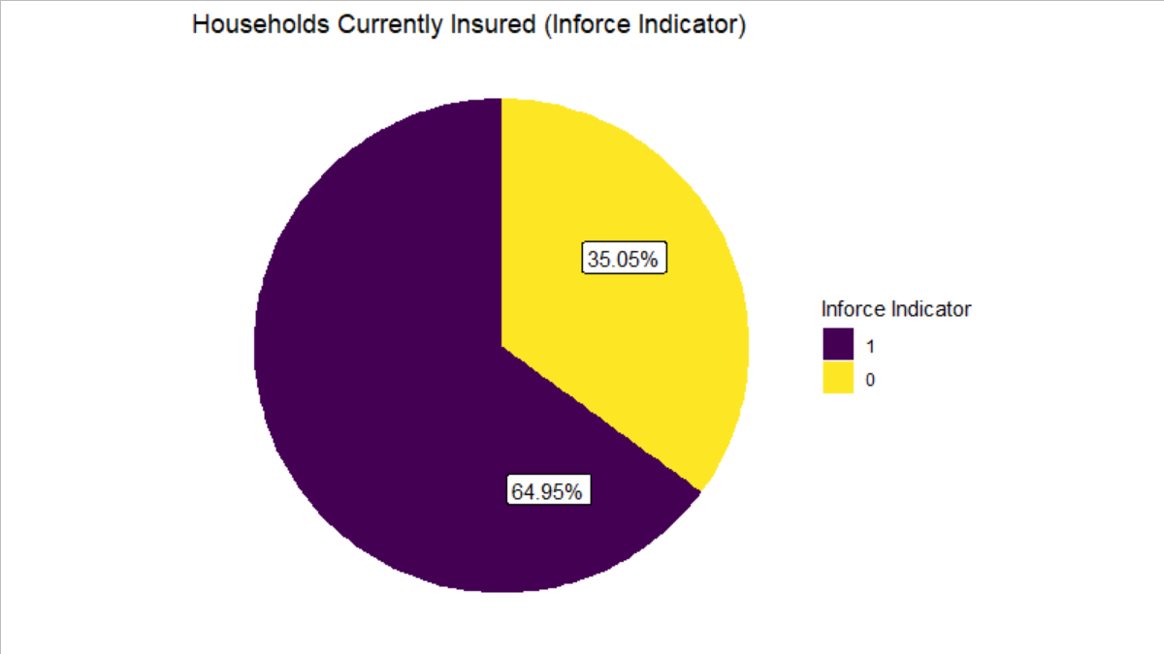
Inforce Indicator
Roughly 2/3 of policyholders are currently insured

Slide 31
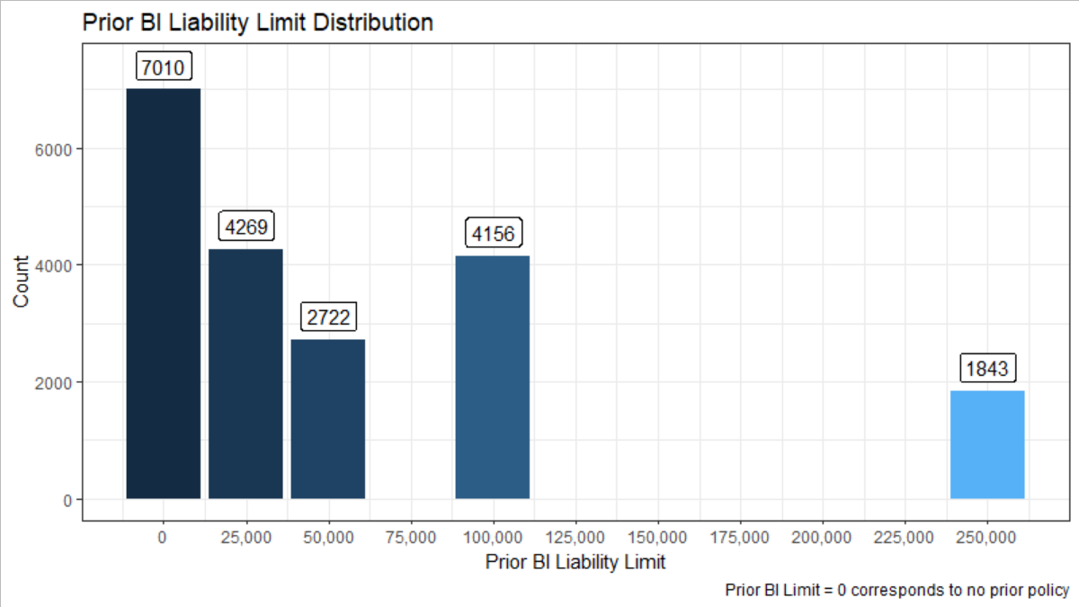
Prior BI Liability Limit Distribution
Most policyholders select lower BI Liability Limits

Slide 32
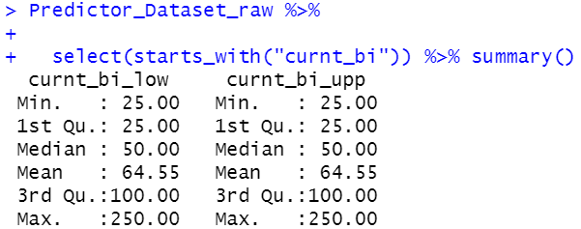
Comparison of (current) BI Liability Limits
Per Person and Per Occurrence BI Liability Limits are identical

Slide 33
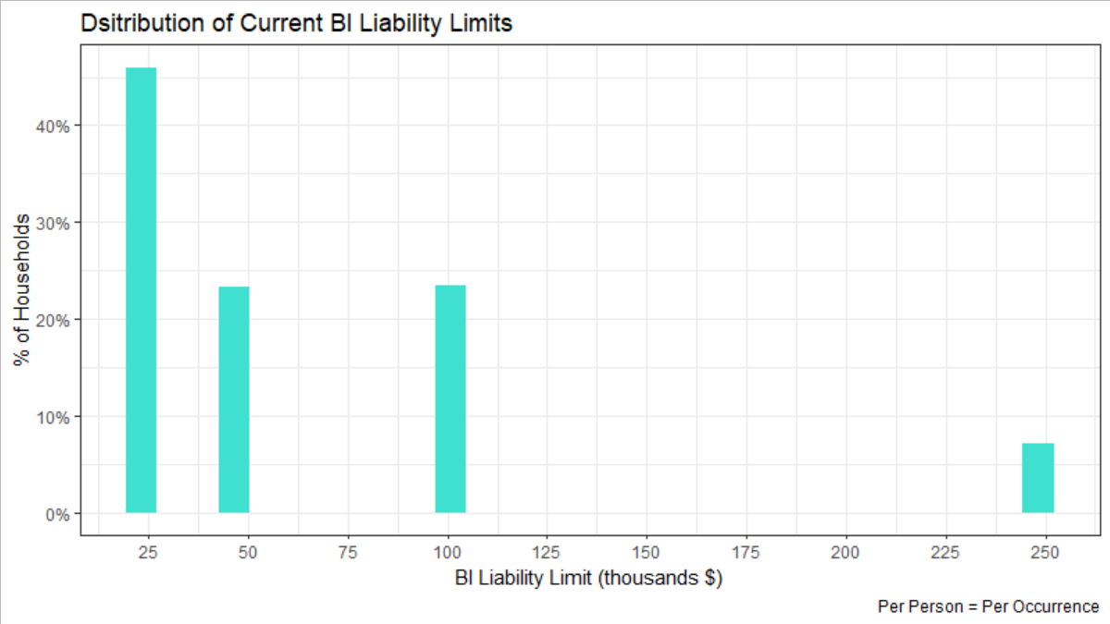
Distribution of Current BI Liability Limits
Most households select the minimum BI Liability Limit of $25k
Notes:
Anecdotally, I believe there is some correlation with selection of higher limits and worse loss experience (e.g. customers who expect to need higher limits, choose higher limits)

Slide 34
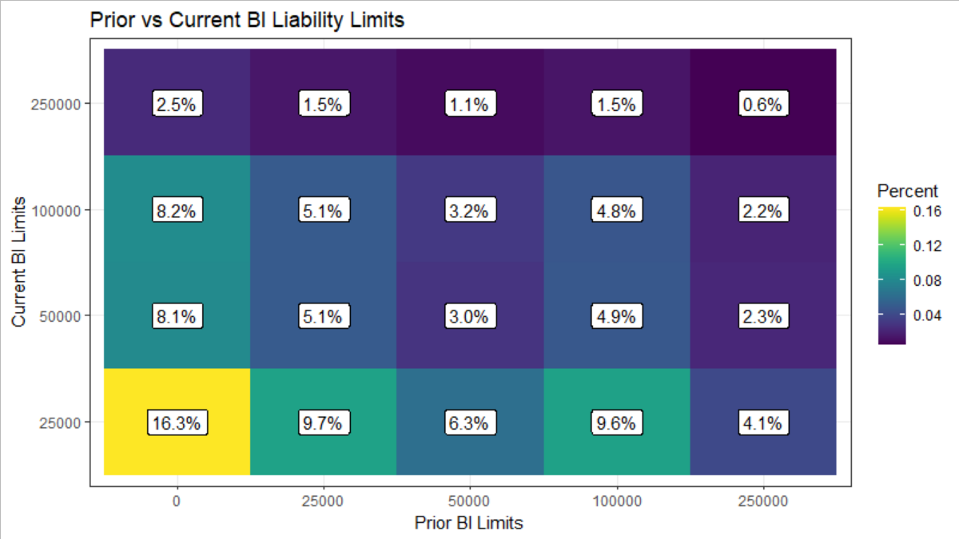
Prior vs Current BI Liability Limits
Most households selected lowest BI Limit ($25k) regardless of prior BI Limit

Slide 35
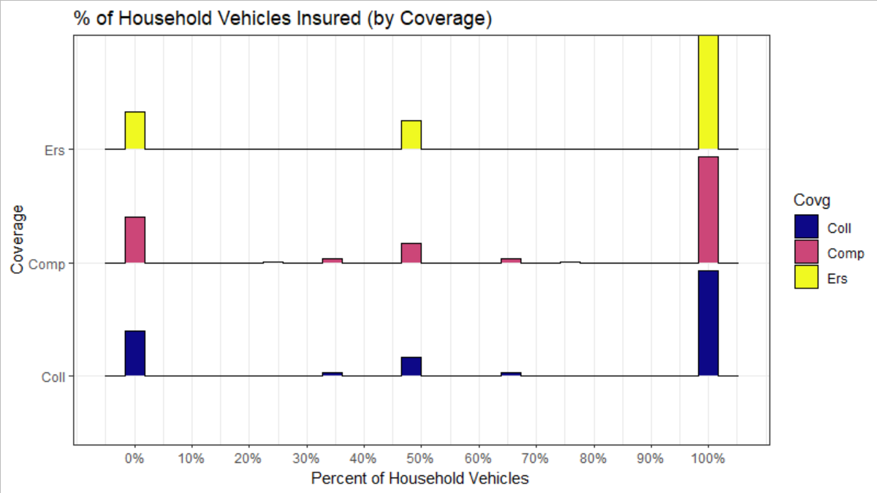
Current Auto Coverage Distribution
Most households insure 100% of their Vehicles for Comprehensive, Collision, and ERS

Slide 36
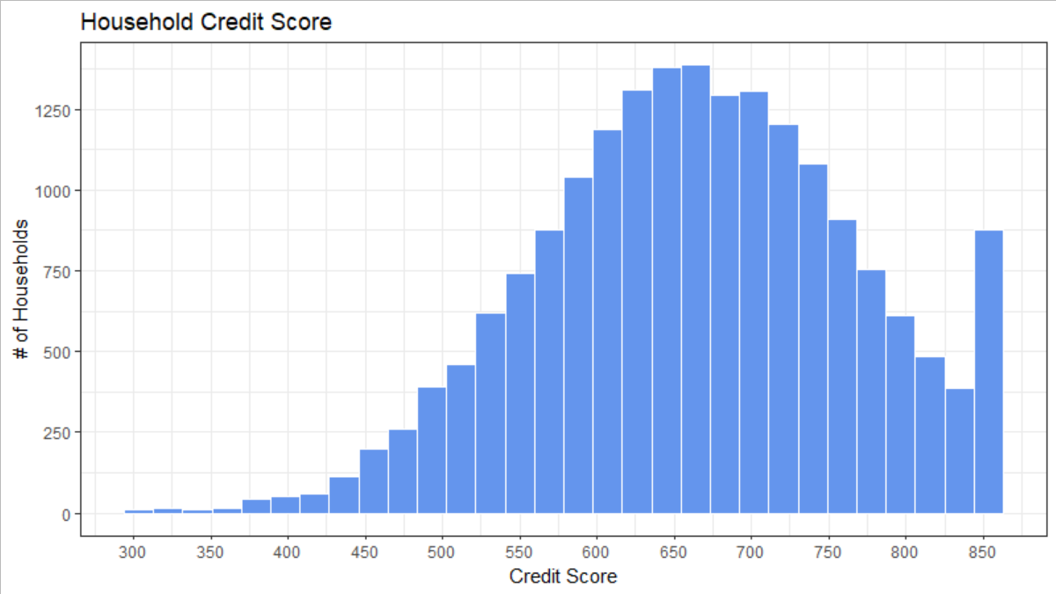
Distribution of Credit Score
Normally Distributed around 650, with point mass at 850
Notes:
Some very impressive Credit Scores

Slide 37
4a. Cleaning Predictor Dataset
Adjusting for Missing Values

Slide 38
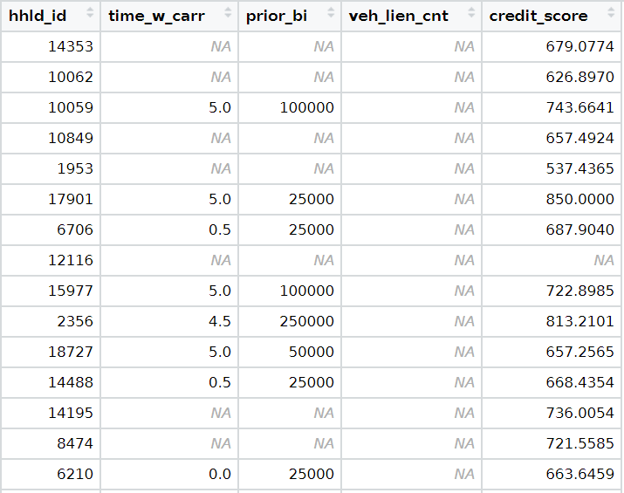
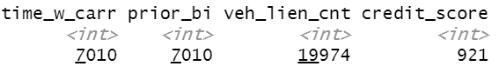
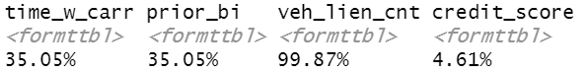
Identifying Missing Values (NAs)
4 Variables contain Missing Values
Count and % NA:

Slide 39
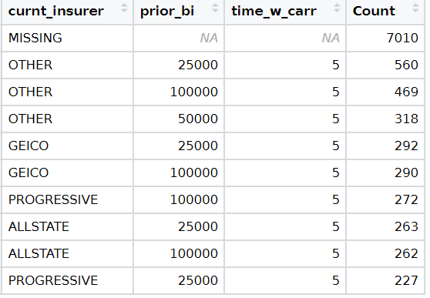
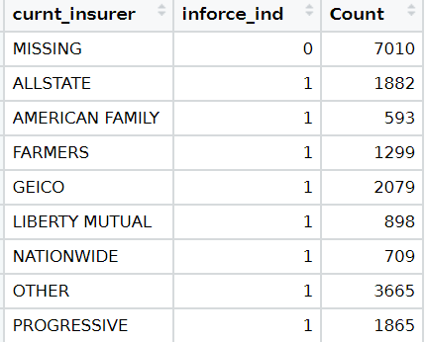
“Time with Carrier” and “Prior BI Limit”
Missing Values associated with “Missing” Current Insurer, and no policy inforce (inforce_ind =0)
These variables are missing due to policyholder not currently having a policy inforce: Replace missing values with 0 to represent 0 time with prior insurer, and no prior BI Limit

Slide 40
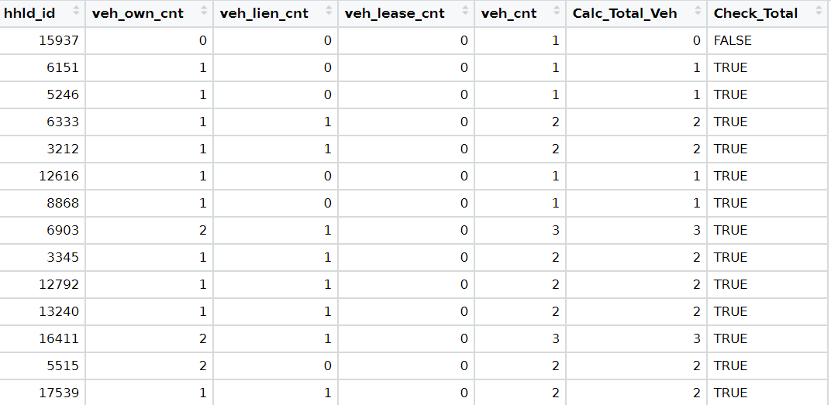
“Vehicle Lien Count”
Total Vehicles = Owned + Liened + Leased for 25/26 Non-Missing rows
Reasonable to assume this relationship holds, therefore:
Impute Vehicle Lien Count as Total Vehicles – (Owned Vehicles + Leased Vehicles)

Slide 41
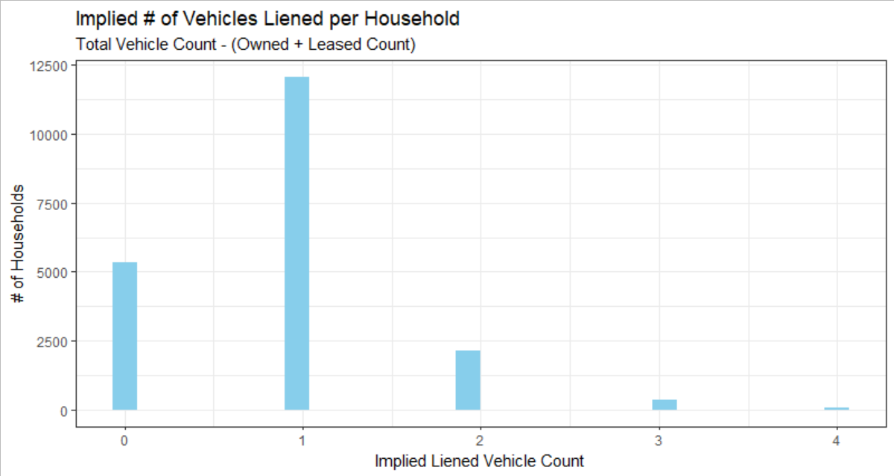
Vehicle Lien Count
Implied Vehicle Lien Count appears reasonable

Slide 42
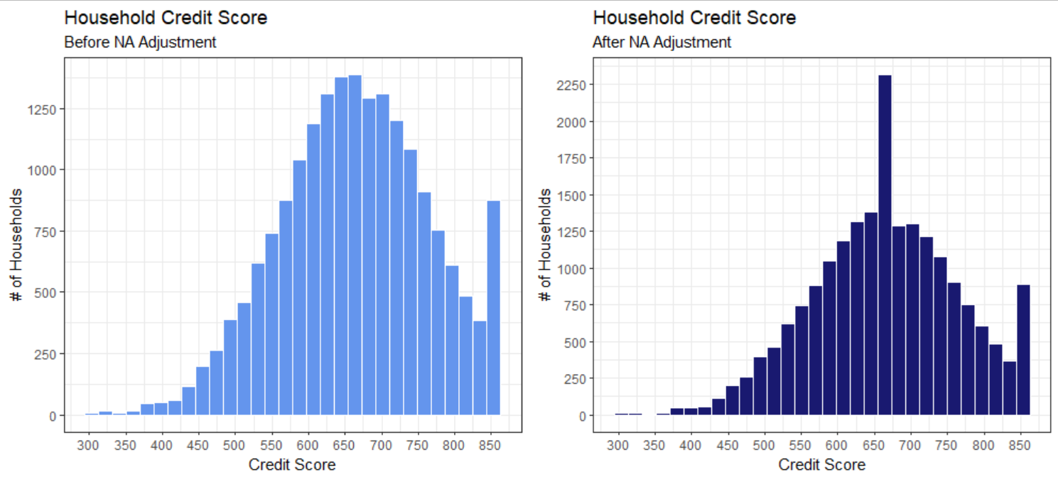
Credit Score
5% of Credit Score is Missing at Random
Missing Values Replaced with Mean Credit Score

Slide 43
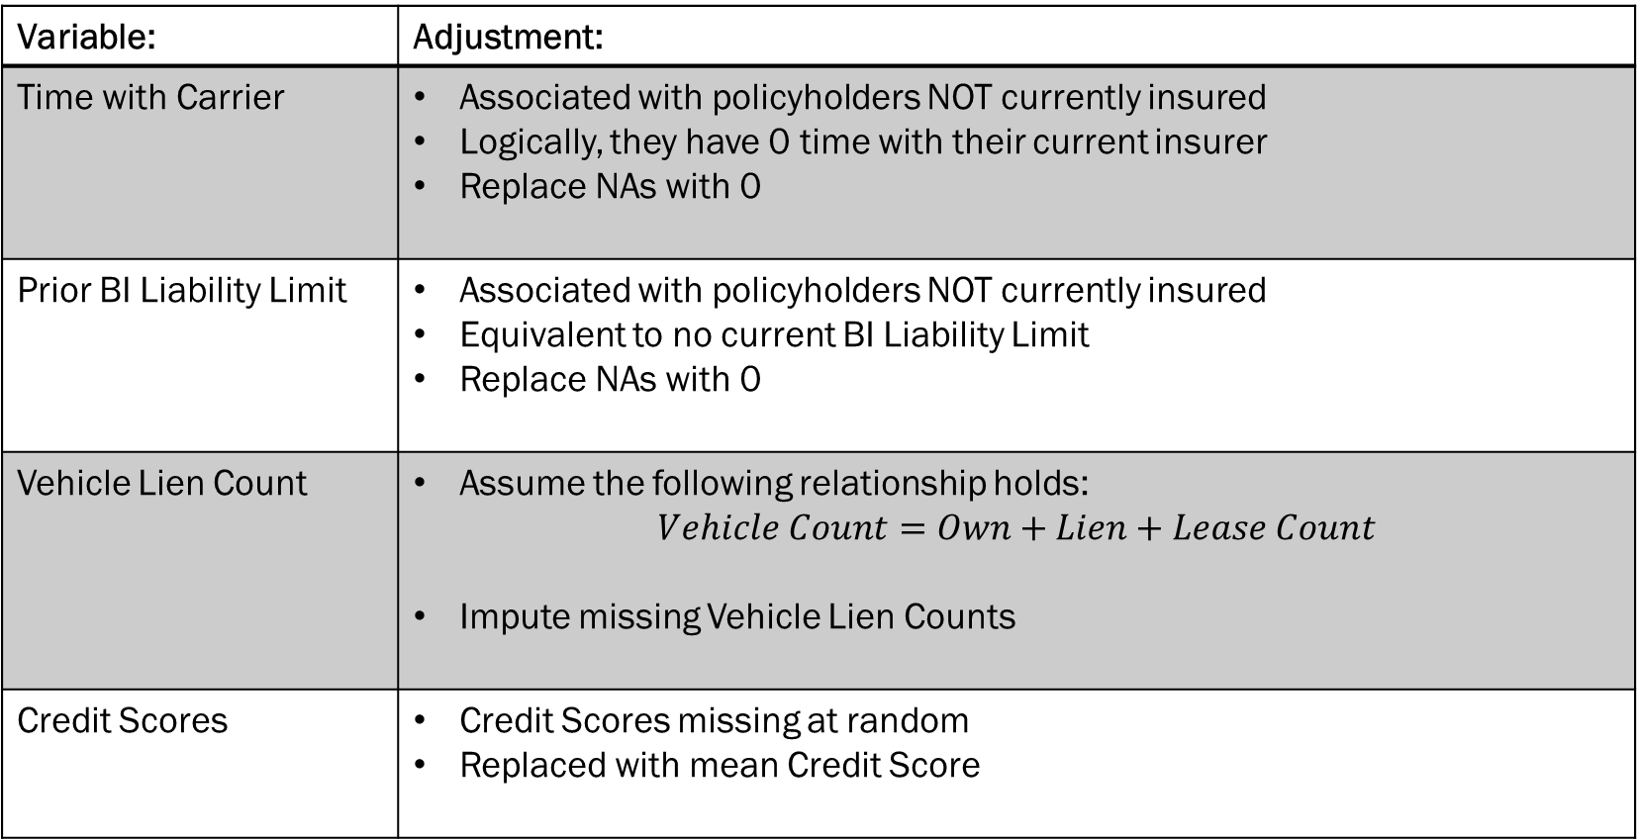
Summary of NA Adjustments
Variable: | Adjustment:
Time with Carrier | Associated with policyholders NOT currently insured Logically, they have 0 time with their current insurer Replace NAs with 0
Prior BI Liability Limit | Associated with policyholders NOT currently insured Equivalent to no current BI Liability Limit Replace NAs with 0
Vehicle Lien Count | Assume the following relationship holds: $Vehicle Count=Own+Lien+Lease Count$ Impute missing Vehicle Lien Counts
Credit Scores | Credit Scores missing at random Replaced with mean Credit Score

Slide 44
4b. Cleaning Predictor Dataset
Other Adjustments

Slide 45
Summary of Additional Adjustments (1/2)
Variable: | Problem and Adjustment:
Zip Code | Censored, and unable to match to state Removed feature – infeasible to include every zip code level into model
curnt_bi_low curnt_bi_upp | Per Person and Per Occurrence BI Liability Limits Identical Keep one, and renamed to “BI Limit” Converted limit from ($1000) to $
hoh_married | Values of TRUE/FALSE Converted to 0/1 indicator variable called “hoh_married_ind”
curnt_insurer | Combined named (larger) insurers into a “Major_Insurer” bucket to reduce levels and improve interpretability Individual insurer’s UW practices frequently change over time, reducing future reliability of individual major insurers Re-labeled “Other” insurers to “Minor_Insurer”

Slide 46
Summary of Additional Adjustments (2/2)
Variable: | Problem and Adjustment:
Credit Score | Observed non-integer Credit Scores Rounded to Integer values

Slide 47
5. Correlation Analysis and Adjustments

Slide 48
Recall: Group Related Predictor Variables together for Analysis
Grouped variables have higher risk of correlation and/or multi-collinearity

Slide 49
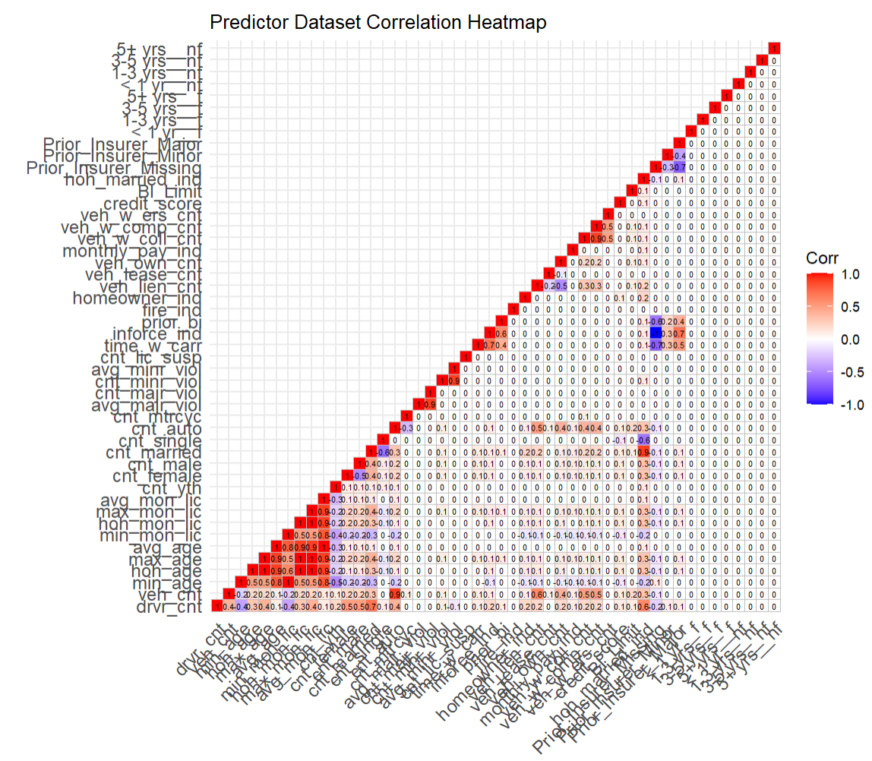
Correlation Heatmap

Slide 50
Predictor Dataset Correlation
Strong Positive Correlation
Category: | Comments/Description:
Age and Months Licensed | Age summary statistics correlated (expected) Months Licensed summary statistics correlated (expected) Older drivers have typically been licensed for longer
Driver Demographics | Count of Married Drivers and Head-of-Household Marital Status (intuitive) Count of Married Drivers, Head-of-Household Marital Status, and Driver Count – married households are more likely to have more drivers
Vehicle & Automobile Count | 90%+ of vehicles owned are automobiles, hence the correlation
Traffic Violations | Traffic Violation summary statistics correlated (expected)
Collision & Comprehensive Coverage | Most households have 100% of their vehicles covered for both collision and comprehensive

Slide 51
Predictor Dataset Correlation
Strong Negative Correlation
Category: | Comments/Description:
Driver Demographics | Count of Married Drivers/Head-of-Household Marital Status and Count of Singles (intuitive) Count of Male and Female Drivers (intuitive)

Slide 52
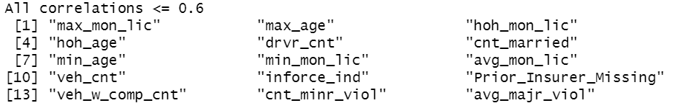
Correlation Filtering based on Mean Absolute Correlation
Recommended Variables to remove based on caret::findCorrelation
Arguments:
cutoff = 0.6 Maximum absolute pair-wise correlation cutoff between variables
exact = TRUE Re-evaluate average correlation at each step

Slide 53
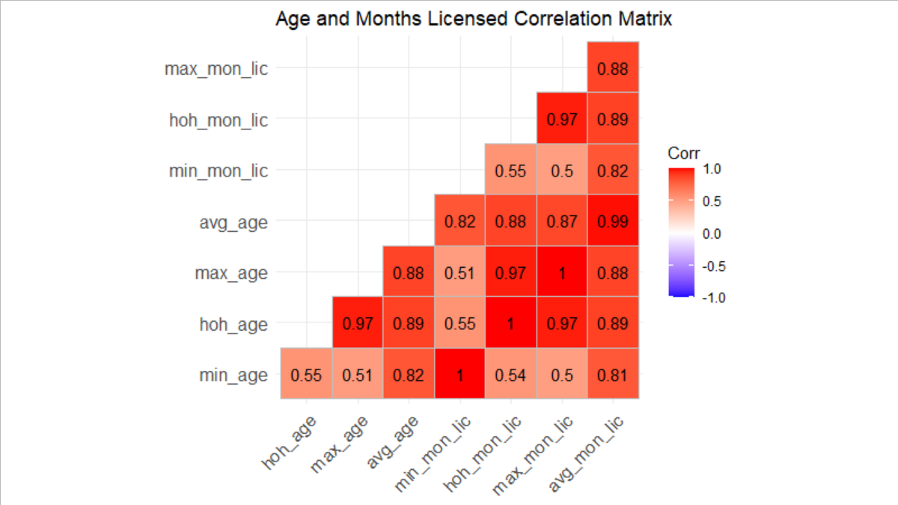
1. Age and Months Licensed
Perform PCA to remove correlation/multi-collinearity, and reduce dimensions

Slide 54
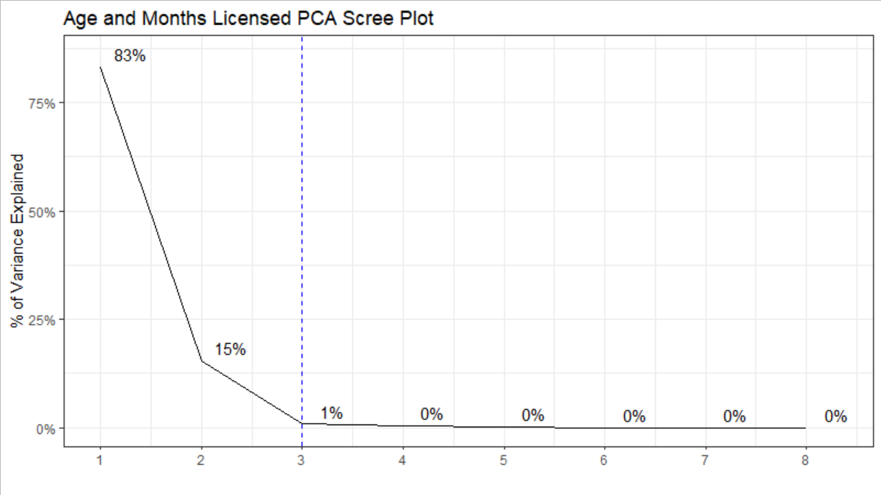
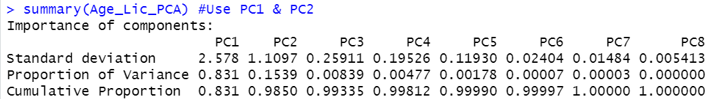
1. Age and Months Licensed
Use PC1 and PC2 which explain 98% of the variance

Slide 55
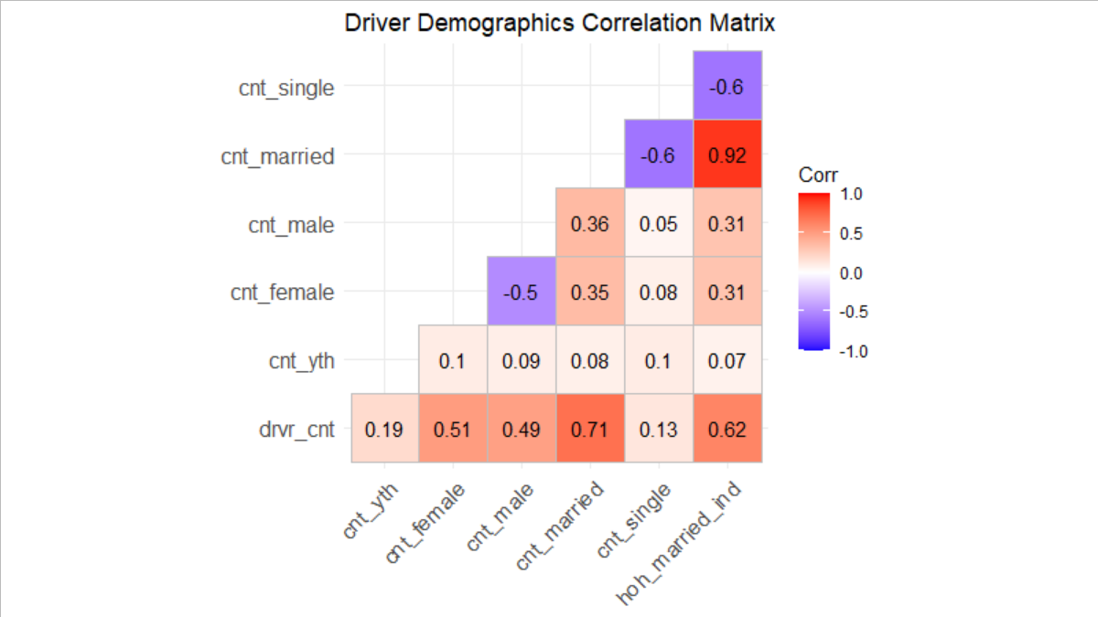
2. Driver Demographics
Remove Head-of-Household Married Indicator based on Correlation Filtering?
Based on high risk of multi-collinearity and (to a lesser extent) dimensionality reduction benefit, perform PCA on Driver Demographics

Slide 56
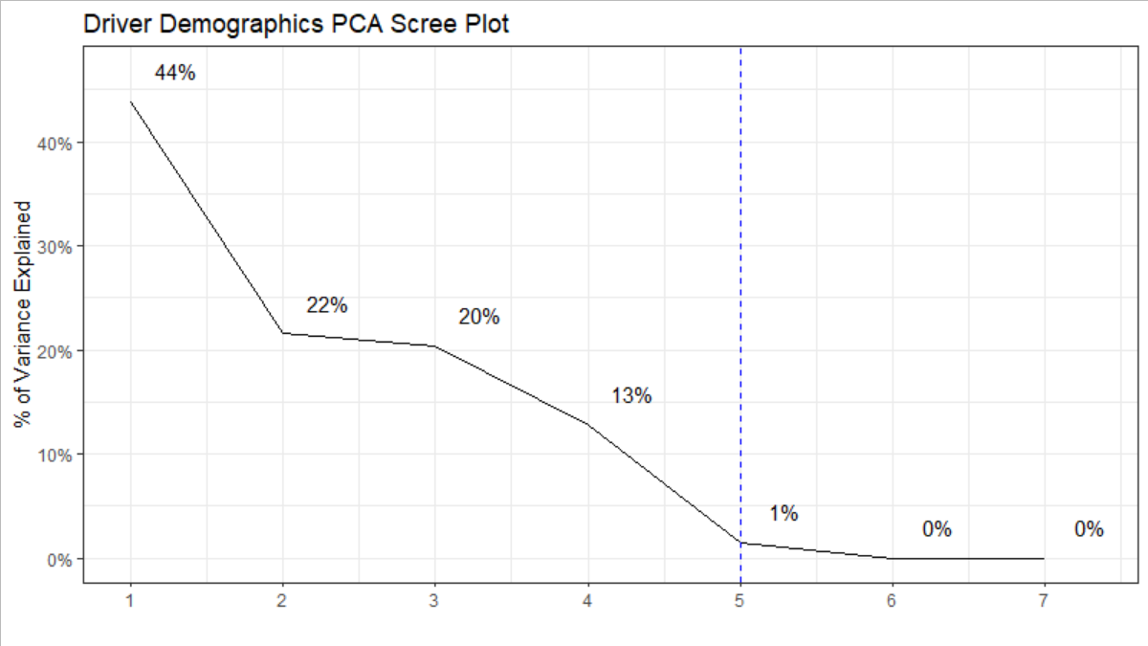

2. Driver Demographics
Select PC1-PC4 which explain 98% of the variance

Slide 57

3. Vehicle Count
Perform PCA to prevent multi-collinearity
Notes:
e.g. Vehicle Count = Auto + Motor, Vehicle Count = Lien + Lease + Own

Slide 58


3. Vehicle Count
Select PC1 – PC6 which explain 99% of variance

Slide 59

4. Traffic Violations
As per Correlation Filtering, remove Count Major and Average Minor Violations; No PCA
Notes:
Re-evaluate after PCA adjustments

Slide 60
Summary of Correlation Adjustment (1)
Applied Principal Component Adjustments first
Remove all variables related to Age and Months Licensed
Remove all variables related to Driver Demographics
Remove all variables related to Vehicle Count
… and replace them with their selected Principal Components

Slide 61

Revised Correlation Heatmap (2)

Slide 62

Remaining Correlation
Correlation between variables related to “Prior Insurer”, e.g.
Prior_Insurer_Bucket
inforce_ind
prior_bi
Correlation within different levels of Prior_Insurer_Bucket (expected)
Correlation between variables related to “Traffic Violations” (Previously observed, but wished to re-evaluate after other variables’ PCs)
Age PC2 and Demographics PC1

Slide 63
Correlation Filtering based on Mean Absolute Correlation (2)
Recommended Variables to remove based on caret::findCorrelation
Arguments:
cutoff = 0.6 Maximum absolute pair-wise correlation cutoff between variables
exact = TRUE Re-evaluate average correlation at each step

Slide 64
Summary of Correlation Adjustment (2)
Removed highly correlated variables based on Correlation Filtering recommendations
Removed “inforce_ind”
Removed “cnt_minr_viol” and “avg_majr_viol”
Retained “Prior_Insurer_Buckets” as it would be inappropriate to remove specific levels of the categorical variable (e.g. Missing level)
Retained “Age PC2”:
Do not want to lose explanatory power related to Age (known to be predictive in auto insurance)
Correlation of -0.67 can be acceptable, even if higher than selected threshold (0.6)

Slide 65


Final Correlation Heatmap (3)
All pair-wise correlations > 0.6 have been accounted for
Remaining |Correlations| > 0.5 :

Slide 66
6. Final Modeling Dataset

Slide 67

Clean Claims Data (Dataset 1)
Original Claims Dataset

Slide 68

Cleaning Claims Data (Dataset 1)
Historical Household Loss Experience (pre-2017) may be useful as predictors
Bucket paid loss experience into:
< 1 year ago
1-3 years ago
3-5 years ago
5+ years ago
Split paid loss experience into:
At-Fault (_f)
Not At-Fault (_nf)
Expectation is:
More recent loss experience will be more predictive
At-Fault losses will be more predictive

Slide 69
Final Modeling Dataset

Slide 70
7. Logistic Regression and Model Evaluation

Slide 71
Model Assumptions
Model: Generalized Linear Model (GLM)
Distribution: Binomial
Link Function: Logit Link
Model Validation: 10-Fold Cross Validation
Feature Selection Methodology: Lasso Regression (L1 Regularization)
Lambda: 10-Fold Cross Validation to determine optimal lambda “1se” (within 1 SE of minimum CV error) *1se will result in a slightly more parsimonious model, with comparable accuracy to best model

Slide 72

Fit Initial GLM (version 0) using all available predictors
Significant Features:
Intercept
Prior BI Limit
Credit Score
Prior Insurer – Missing
Age PC1
Age PC2

Slide 73

Evaluate Initial GLM (version 0)
Strong Model Performance with accuracy of 99%

Slide 74


Evaluate Initial GLM (version 0)

Slide 75

Adjust Claims Data (Dataset 1) Predictors
Splits by Year are not significant, and clutter the model – simplify paid claims features
Before:
After:

Slide 76

Re-Fit GLM (version 2) with adjusted Claims Data
Predictors are cleaner, but historical loss experience is still insignificant
Significant Features:
Intercept
Prior BI Limit
Credit Score
Prior Insurer – Missing
Age PC1
Age PC2

Slide 77

Evaluate GLM (version 2)
No significant changes – Model performance remains the same

Slide 78


Evaluate GLM (version 2)

Slide 79

Lasso Regression for Feature Selection
Lasso selected all significant GLM features, except Age PC2
Non-Zero Features:
Intercept
Prior BI Limit
Credit Score
Prior Insurer – Missing
Age PC1

Slide 80

Re-Fit GLM (version 3) using Lasso Selected Features
All features are significant, except Prior Insurer Bucket’s “Minor Insurer” level

Slide 81

Evaluate GLM (version 3)
Consistent model performance despite removal of many features

Slide 82


Evaluate GLM (version 3)

Slide 83

Re-Fit GLM (version 4) with Inforce Indicator
Since only the “Missing” level of Current Insurer is significant, try replacing with “Inforce Ind”
Significant Features:
Intercept
Prior BI Limit
Credit Score
Age PC1
Age PC2
Inforce Indicator (replaced Prior Insurer – Missing)
*Inforce Indicator originally removed due to correlation with Prior Insurer variable **Inforce Indicator is the exact opposite of Current Insurer – Missing

Slide 84

Lasso Regression for Feature Selection
Lasso selected all significant GLM features, except Age PC2
Non-Zero Features:
Intercept
Prior BI Limit
Credit Score
Age PC1
Inforce Indicator (replaced Prior Insurer – Missing)

Slide 85

Re-Fit GLM (version 5) using Lasso Selected Features
All Features are significant (previously, Current Insurer - “Minor Insurer” level was insignificant)

Slide 86

Evaluate GLM (version 5)
Model continues to perform well, and using Inforce Indicator helped simplify model

Slide 87


Evaluate GLM (version 5)

Slide 88

Replace Age PC1
Can we simplify model and improve interpretability by replacing Age PC1?
Negatively correlated with all Age and Months Licensed Variable
Interpret as capturing household drivers’ youthfulness
Most (negatively) correlated with Average Age and Average Months Licensed
Replace Age PC1 with Average Household Age
Age variables are easy to interpret
Age variables are more readily accessible than Months Licensed
~Highest (absolute) correlation with Age PC1
Age_PC1 Correlation with its underlying variables

Slide 89

Re-Fit GLM (version 6) with Average Age
Replace Age PC1 with Average Age

Slide 90

Evaluate GLM (version 6)
Model continues to perform well, and replacing Age PC1 improved model interpretability

Slide 91



Evaluate GLM (version 6)

Slide 92

Final Model and Interpretation
Select GLM (version 6) as Final Model
Logistic Regression Model:
$\log\left(\frac{P}{1−P}\right)=β_{0}+β_{Prior BI Limit}\left(Prior BI Limit\right)+β_{Credit Score}\left(Credit Score\right)+β_{Avg Age}\left(Avg Age\right)+β_{Inforce Ind}\left(Inforce Indicator\right)$
$\log\left(\frac{P}{1−P}\right)=25.87258 −0.00058\left(Prior BI Limit\right)−0.06841\left(Credit Score\right)−0.18792\left(Avg Age\right)+36.27864\left(Inforce Indicator\right)$
Interpretation:
Intercept is the Log Odds of a future claim, given all other predictor variables are 0
While holding all other variables constant,
Continuous variables represent change in the Log Odds Ratio per 1-unit change (e.g. 0.18792 decrease in the log odds of a future claim per 1 year increase in average household age)
Categorical variables represent the relative change in the Log Odds Ratio compared to the base level (intercept) (e.g. 36.27864 increase in the log odds of a future claim if the applicant has a current policy inforce, compared to an applicant without an inforce policy)
Exponentiate the model to convert interpretation from Log Odds: $\log\left(\frac{P}{1−P}\right)$, to Odds: $\frac{P}{1−P}$ (e.g. 1-point increase in household Credit Score will decrease the odds of a future claim by $e^{0.06841}$)

Slide 93
A Note on Quasi-Complete Separation
Quasi-Complete Separation: Logistic Regression is able to (nearly) perfectly predict the response
May indicate model is overfit
Can be caused by small, imbalanced datasets (relative to the number of predictors)
Potential Solutions:
“Do Nothing”
Remove problematic variable(s)
Collapse categorical variable levels
Regularization/Penalized Regression
Bayesian Methods
Firth Logistic Regression
Explored Regularization (stand-alone LASSO) and Firth Logistic Regression solutions, but yielded similar results to selected model
Source: https://stats.oarc.ucla.edu/other/mult-pkg/faq/general/faqwhat-is-complete-or-quasi-complete-separation-in-logistic-regression-and-what-are-some-strategies-to-deal-with-the-issue/

Slide 94
Concluding Comments
Model is conditioned on stated assumptions (e.g. identical coverage, loss development …)
Model should be adjusted with consideration of Business Needs/Purpose:
Stakeholder needs/capabilities
Accessibility of features (e.g. operational costs)
Legality/Acceptability of variables, especially if model is to be filed (e.g. Credit Score)
IT capabilities
Options for further Model Improvement:
Bootstrapping
AUROC and threshold adjustment to improve sensitivity/specificity
Advanced ML modeling techniques (e.g. Tree-based models)
Ensembling

